Slide 1
Exp_01-Dual Color LED
秦华谦21312683
Main code and comments
int redPIN = 11; // Variable to store the pin number for the red LED
int greenPIN = 10; // Variable to store the pin number for the green LED
int val = 0; // Variable to store the current value
void setup() {
pinMode(redPIN, OUTPUT); // Set the red LED pin as output
pinMode(greenPIN, OUTPUT); // Set the green LED pin as output
Serial.begin(9600); // Initialize the serial communication at 9600 baud rate
}
void loop() {
// Fade in the red LED and fade out the green LED
for (val = 255; val > 0; val--) { // Loop from 255 to 0
analogWrite(redPIN, val); // Set the brightness of the red LED
analogWrite(greenPIN, 255 - val); // Set the brightness of the green LED (opposite of red)
Serial.println(val, DEC); // Print the current value to the serial monitor
delay(30); // Delay for 30 milliseconds
}
// Fade in the red LED and fade out the red LED
for (val = 255; val > 0; val--) { // Loop from 255 to 0
analogWrite(redPIN, val); // Set the brightness of the red LED
analogWrite(redPIN, 255 - val); // Set the brightness of the red LED (opposite of previous value)
Serial.println(val, DEC); // Print the current value to the serial monitor
delay(30); // Delay for 30 milliseconds
}
}

Slide 2
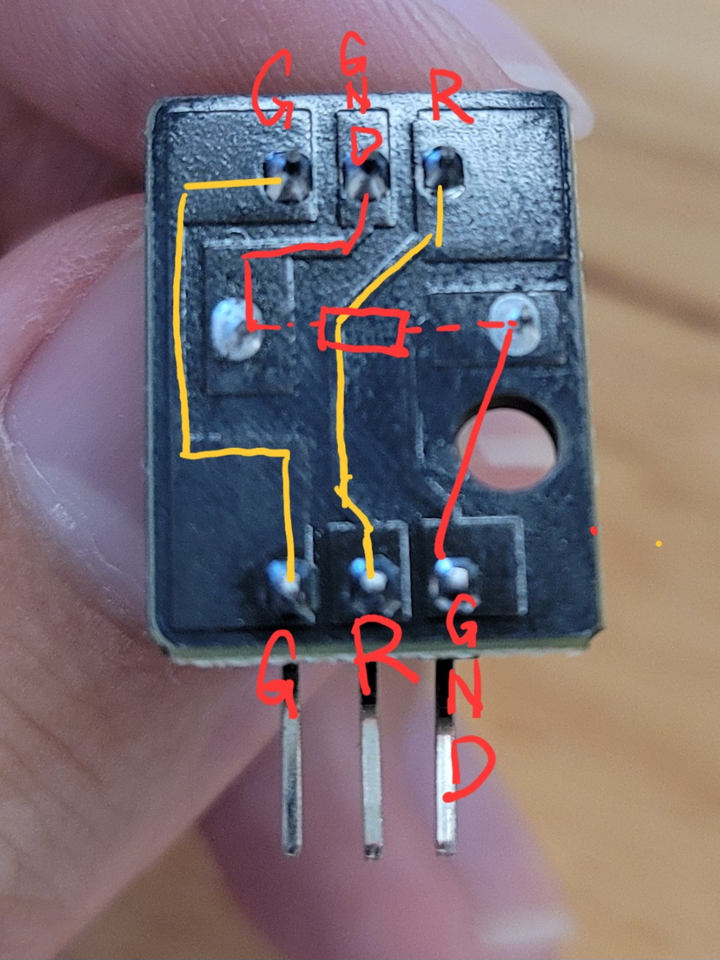
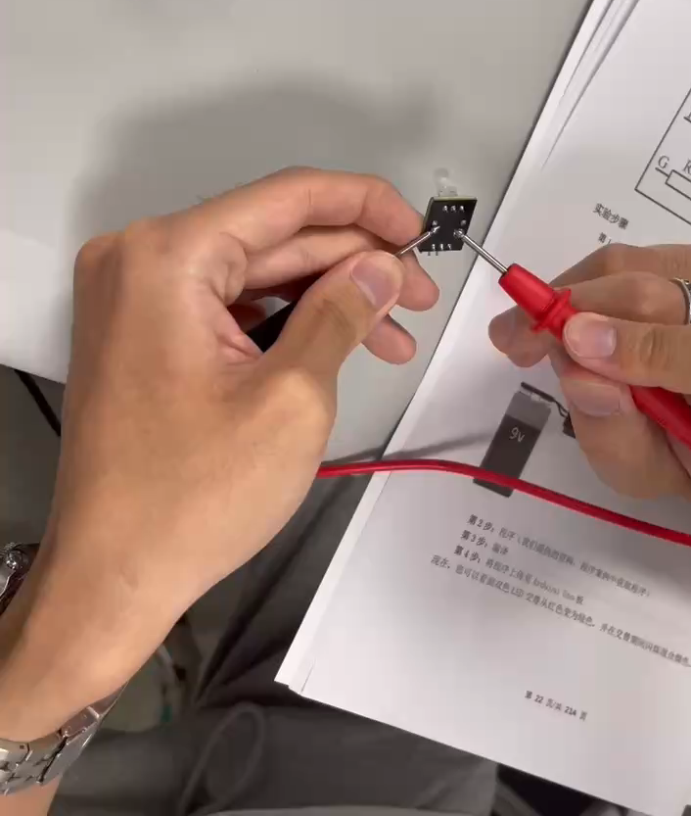
Exp_01-Dual Color LED
秦华谦21312683
Main problems encountered
在一次按照R-GND-B的顺序连接三个引脚的时候发现只亮红灯，分析电路发现三个引脚的顺序是GND-R-B
电路图如下：
用万用表检测视频如下：

Slide 3
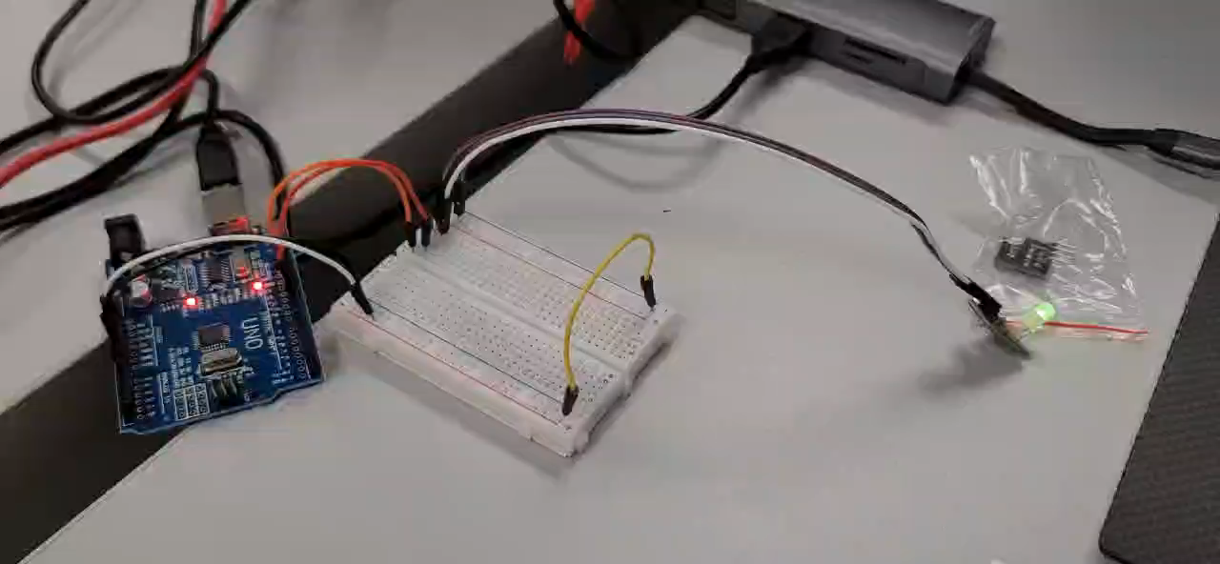
Exp_01-Dual Color LED
秦华谦21312683
Experiment video

Slide 4
Exp_03-RGB-LED
//由三种光形成的色谱
color(255,0,0);//R:255,G:0,B:0**********红色
delay(1000);
color(255,255,0);//R:255,G:255,B:0******黄色
delay(1000);
color(0,255,0);//R:0,G:255,B:0**********绿色
delay(1000);
color(0,255,255);//R:0,G:255,B:255******青色
delay(1000);
color(0,0,255);//R:0,G:0,B:255**********蓝色
delay(1000);
color(255,0,255);//R:255,G:0,B:255******紫色
delay(1000);
color(255,255,255);//R:255,G:255,B:255**白色
delay(1000);
}
void color(unsigned char red,
unsigned char green,unsigned char blue
analogWrite(redPin,red);
analogWrite(greenPin,green);
analogWrite(bluePin,blue);
}
Main code and comments
const int redPin=11;//引脚的定义
const int greenPin=10;
const int bluePin=9;
void setup()
{
pinMode(redPin,OUTPUT); //引脚分配
pinMode(greenPin,OUTPUT);
pinMode(bluePin,OUTPUT);
}
void loop()
{
//基本的3种颜色：红、绿、蓝
color(255,0,0);//R:255,G:0,B:0********红色
delay(1000);//延时一秒
color(0,255,0);//R:0,G:255,B:0********绿色
delay(1000);
color(0,0,255);//R:0,G:0,B:255********蓝色
delay(1000);//延时3秒

Slide 5
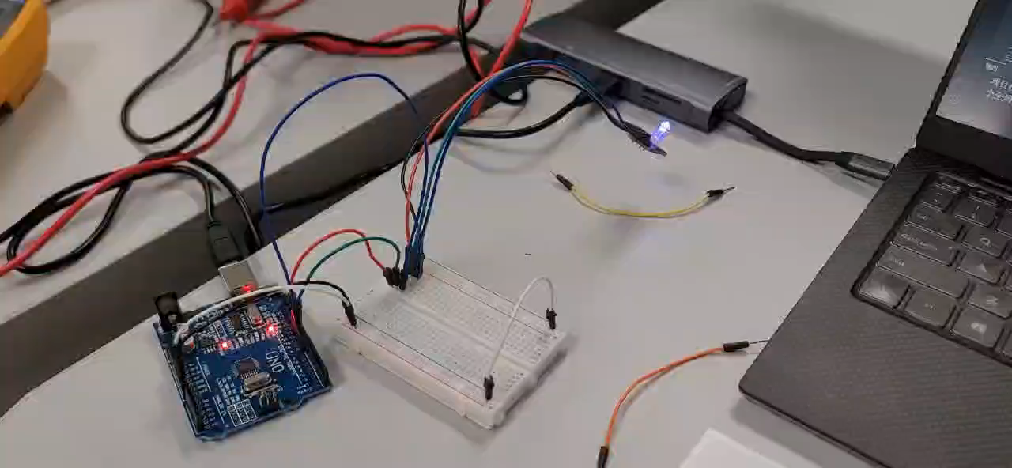
Exp_03-RGB-LED
秦华谦21312683
Experiment video

Slide 6
Exp_03-I2C LCD1602液晶显示
秦华谦21312683
Main code and comments
#include <Wire.h>//include the libarary code
#include <LiquidCrystal_I2C.h>
char array1[]="HuaQian Chin "; //the string to print on the LCD
char array2[]="Hellow World! ";
int tim = 500; //the value of the delay time // initialize the library with the numbers of the interface pins
LiquidCrystal_I2C lcd(0x27, 16, 2); //set the LCD address to 0x27 for a 16 chars and 2 line display
/****************************************************/ void setup()
{
lcd.init(); //initialize the led
lcd.backlight(); //open the backlight
} /**********************************************************/
void loop()
{
lcd.setCursor(15, 0); //set the cursor to column 15, line 0
for (int positionCounter1 = 0; positionCounter1 < 26; positionCounter1++)
{
lcd.scrollDisplayLeft(); //Scrolls the contents of the display one space to the left.
lcd.print(array1[positionCounter1]); //Print a massage to the LCD.
delay(tim); //wait for 250 microseconds
}
lcd.clear(); //Clears the LCD screen and positions the cursor in the upper-left corner.
lcd.setCursor(15, 1); //Set the cursor to column 15, line 1
for (int positionCounter = 0; positionCounter < 26; positionCounter++)
{
lcd.scrollDisplayLeft(); //Scrolls the contents of the display one space to the left.
lcd.print(array2[positionCounter]); //Print a message to the LCD.
delay(tim); //wait for 250 microseconds
}
lcd.clear(); //Clears the LCD screen and positions the cursor in the upper-left corner.
}

Slide 7
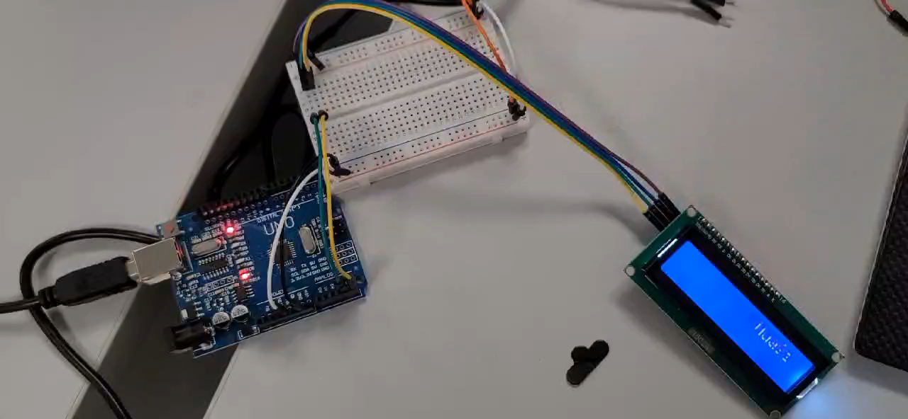
Exp_03-I2C LCD1602液晶显示
秦华谦21312683
Experiment video

Slide 8
Exp_03-I2C LCD1602液晶显示
秦华谦21312683
Main problems encountered
LCD显示屏最开始的时候无法显示内容，后来在调节了背面的“背光调节”旋钮以后才正常显示
尝试探究这一问题出现的原因：
调节旋钮实际上是通过调节V0引脚调节显示屏的对比度：
液晶显示器对比度调整端，接正电源时对比度最弱，接地电源时对比度最高（对比度过高时会产生“鬼影”，使用时可以通过一个10K的电位器调整对比度）
液晶显示器的对比度实际上调的是加在液晶上的极化电压，这个电压越高时，最黑和最白之间的差别更明显，其实白是不会变的，因为不加电时就是白，加大电压，只会让黑的更黑，透光性更差，但到一定程度时就不能再加这个电压了，否则可能让白的也开始变黑，甚至最后变成负像。适当的对比度能让我们看到更多画面细节，色彩感觉上更艳丽丰富.

Slide 9
备注：
本实验所有源码已经上传至本人的GitHub仓库，欢迎前往指正
https://github.com/pbcn2/Code-of-Sensor-Principle-And-Application-exp

